Slide 1



Machine Learning Case Study: Iris Classification
Iris Flower Classification Using the K-Nearest Neighbors Algorithm
By Najwa Quratul Aini
Source of the Dataset:
scikit-learn

Slide 2
INTRODUCTION & OBJECTIF
The Iris dataset is one of the most well-known datasets in the field of machine learning, often used to demonstrate classification techniques. It contains measurements of sepal and petal dimensions for three species of iris flowers. In this project, I aim to classify these species using the K-Nearest Neighbors (KNN) algorithm due to its simplicity and effectiveness in handling small datasets with clear feature distinctions.
The objective of this project is to classify iris flowers into their respective species (Iris setosa, Iris versicolor, and Iris virginica) using the K-Nearest Neighbors (KNN) algorithm, evaluating model performance through accuracy and confusion matrix, and visualizing results such as decision boundaries.

Slide 3
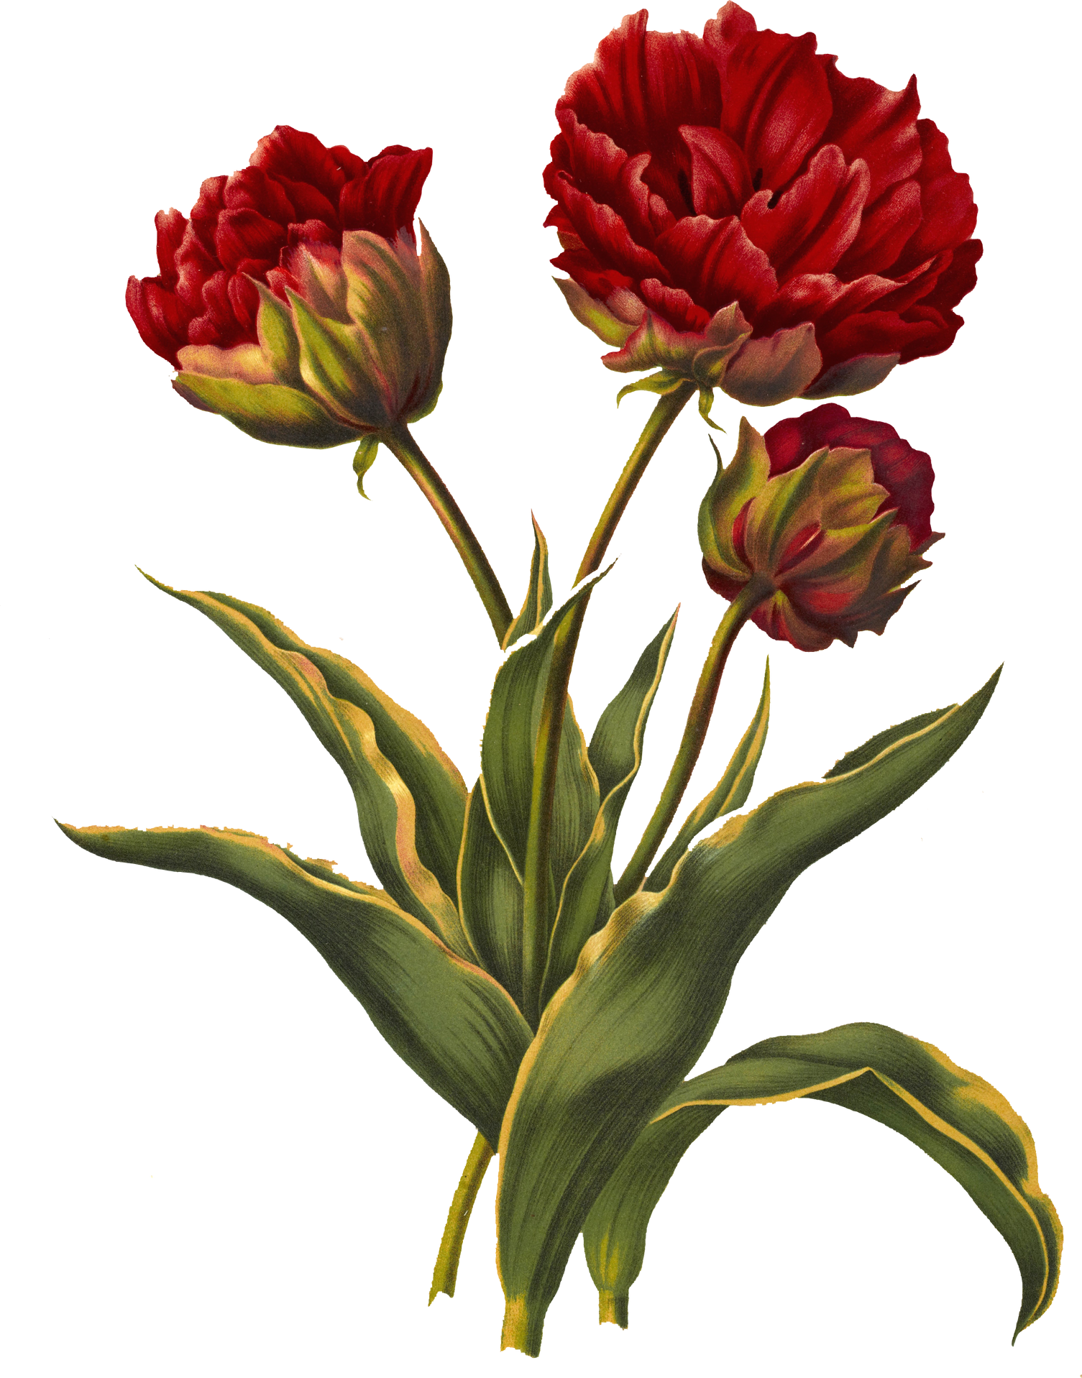







TOOLS USED

Slide 4
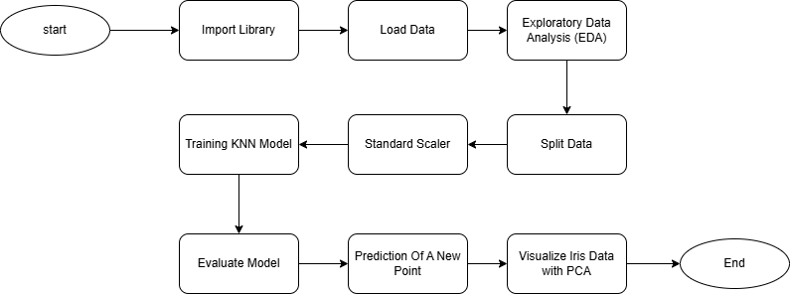
FLOWCHART
TOO USED

Slide 5
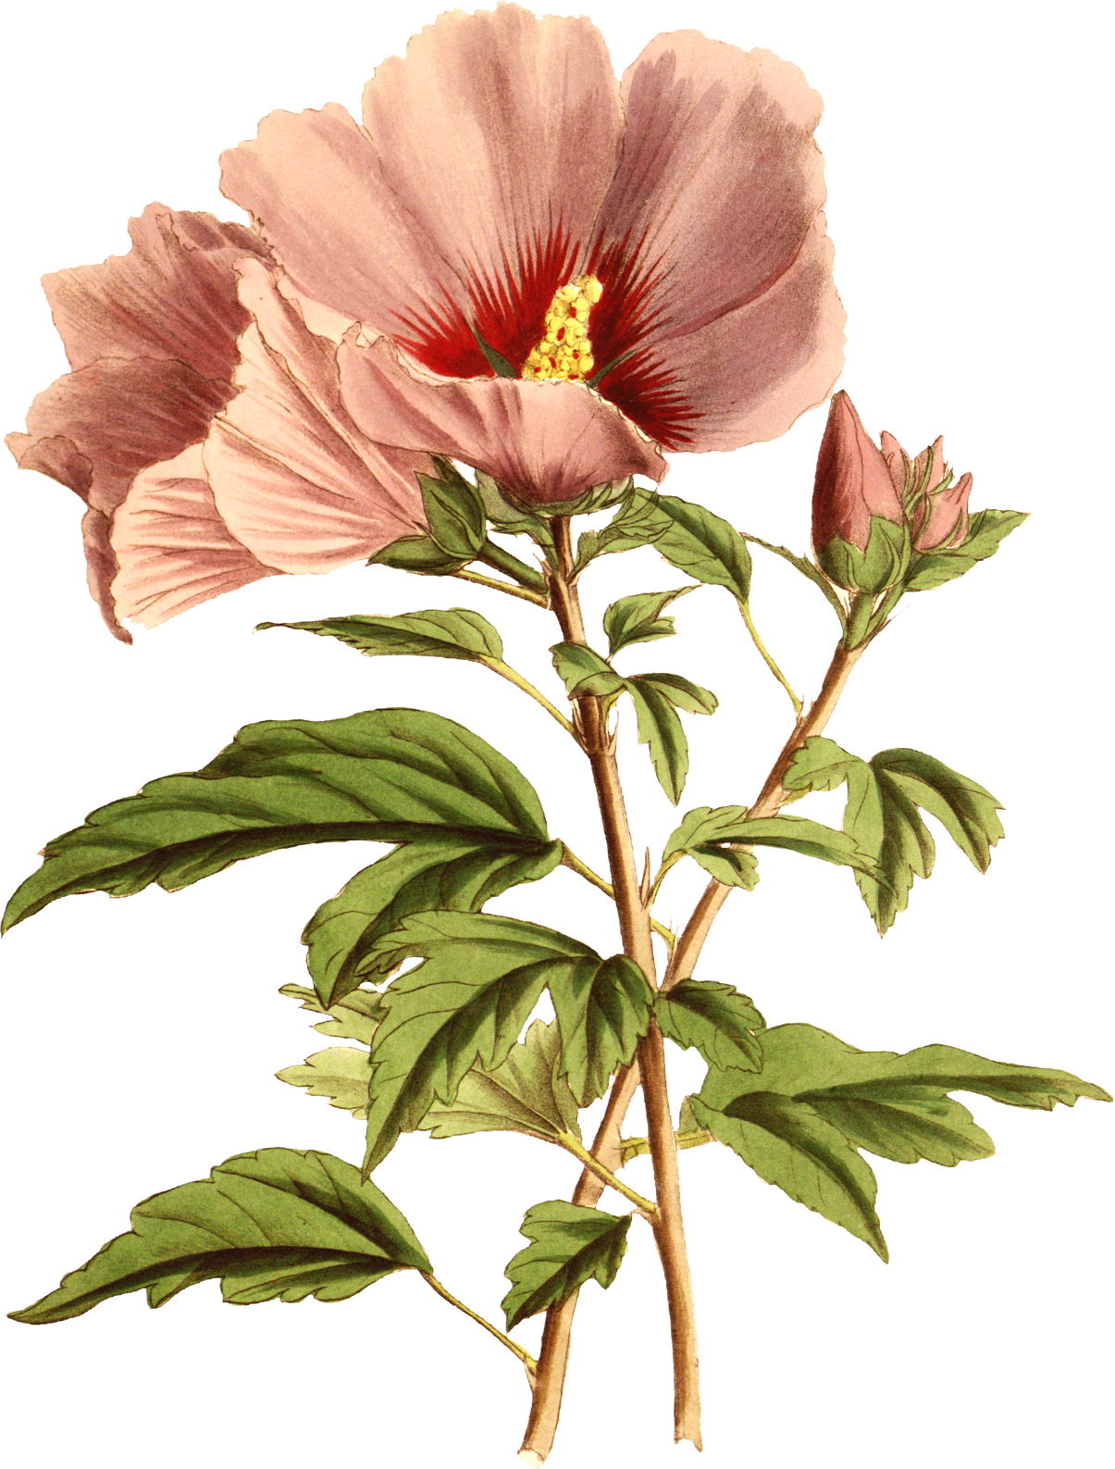

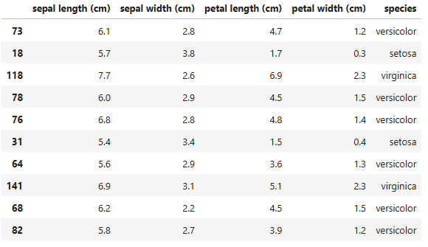
Dataset
The dataset below displays 10 random samples from the Iris dataset that has been loaded and processed. Each row in the table includes four features: sepal length, sepal width, petal length, and petal width, along with an additional column indicating the corresponding flower species (setosa, versicolor, or virginica).

Slide 6
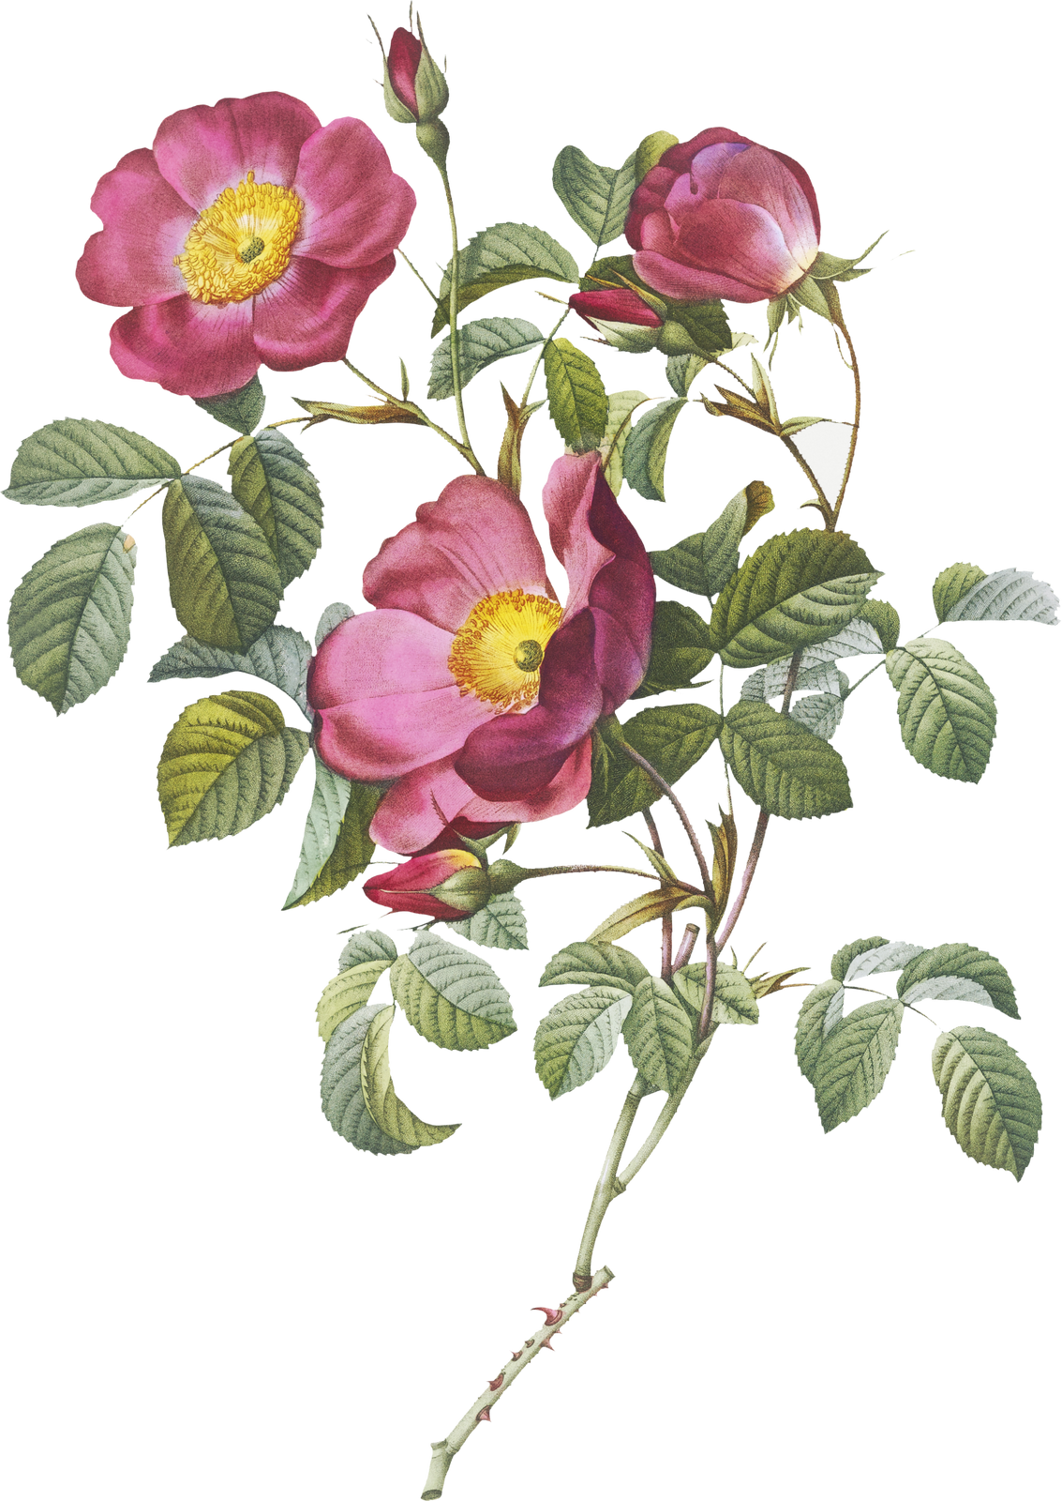
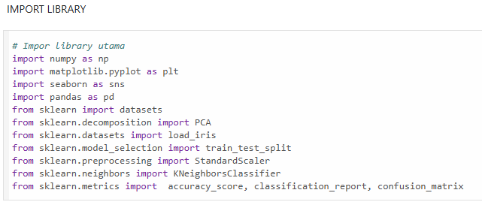
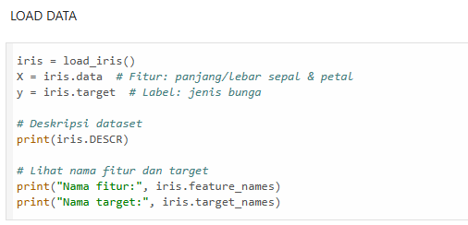
IMPORT LIBRARY & LOAD DATA
IMPORT LIBRARY
Here are some libraries used in classifying the Iris dataset using the KNN algorithm.
LOAD DATA
The dataset used is the Iris dataset, which contains various attributes (sepal length, sepal width, petal length, and petal width) for three different species of Iris flowers: Setosa, Versicolor, and Virginica.

Slide 7
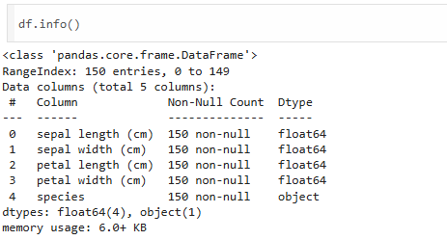
EXPLORATORY DATA ANALYSIS (EDA)

Slide 8
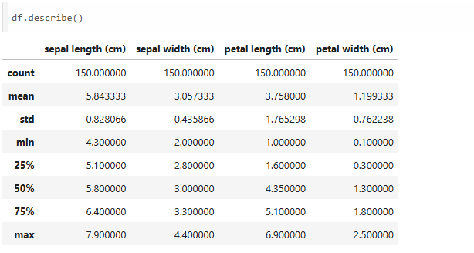
EXPLORATORY DATA ANALYSIS (EDA)

Slide 9
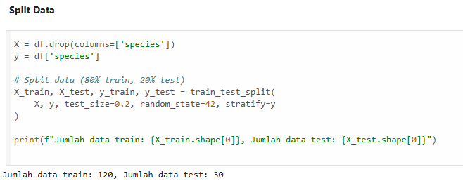
SPLIT DATA (Train-Test Split)
The code snippet separates the Iris dataset into features (X) and the target variable (y), where X includes the flower measurements and y contains the species labels. It then uses the train_test_split function to divide the data into training (80%) and testing (20%) sets, ensuring that the class distribution is preserved with the stratify parameter. Finally, it prints the number of entries in both the training and testing datasets.

Slide 10
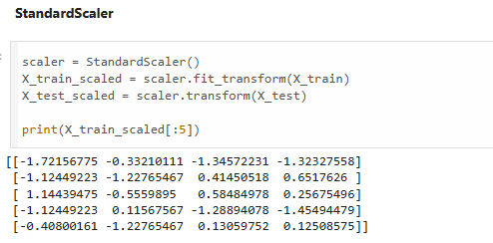
STANDARD SCALER (Normalisasi Fitur)
The code uses StandardScaler from sklearn.preprocessing to standardize the training data (X_train) and test data (X_test). This standardization process transforms the data to have a mean of 0 and a standard deviation of 1, which is important to ensure that machine learning models are not biased by the scale differences between features. fit_transform() is applied to X_train to compute the mean and standard deviation, then apply the transformation to the training data, while transform() only applies the same scaling to X_test. This ensures the model is trained and tested with consistently treated data.

Slide 11
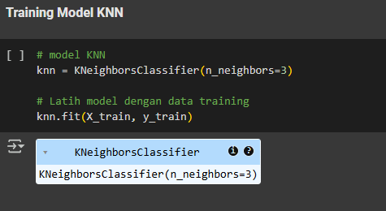
TRAINING MODEL KNN
In this code snippet, a K-Nearest Neighbors (KNN) model is created using the KNeighborsClassifier class with n_neighbors set to 3, meaning the model will consider the three nearest neighbors when making predictions. The model is then trained using the training data by calling the fit method, which takes the feature set X_train and the corresponding target labels y_train as inputs. This process allows the KNN algorithm to learn the relationship between the features and the target variable, enabling it to make predictions on new, unseen data based on the proximity of the data points in the feature space.

Slide 12
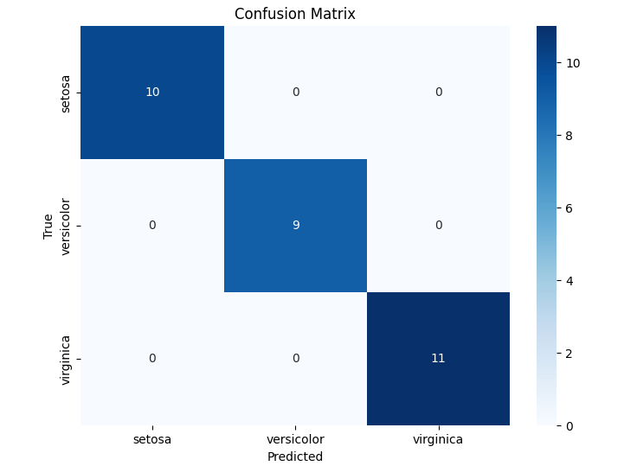
EVALUASI MODEL (Confusion Matrix, Classification Report, Accuracy)

Slide 13
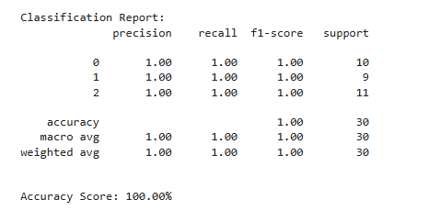
EVALUASI MODEL (Confusion Matrix, Classification Report, Accuracy)

Slide 14
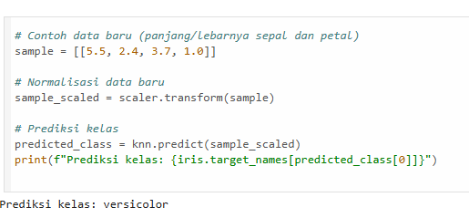
Prediction Of A New Point.
A new sample with values [[5.5, 2.4, 3.7, 1.0]] is defined for the sepal length, sepal width, petal length, and petal width. This sample is normalized using a previously trained scaler. After normalization, the KNN model predicts the class of the sample, and the result indicates that the sample is classified as "versicolor."

Slide 15
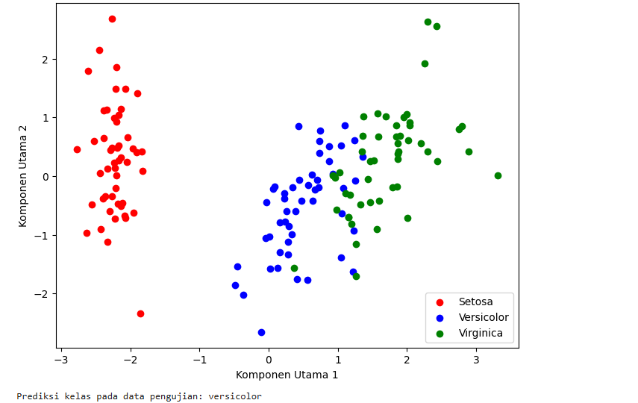
Iris Data Visualization with PCA

Slide 16
THANK YOU
https://www.linkedin.com/in/najwa-quratul-aini-8aa966331/
najwaaquratl@gmail.com

